Slide 1
Model 2- Finite Mixture Model

Slide 2
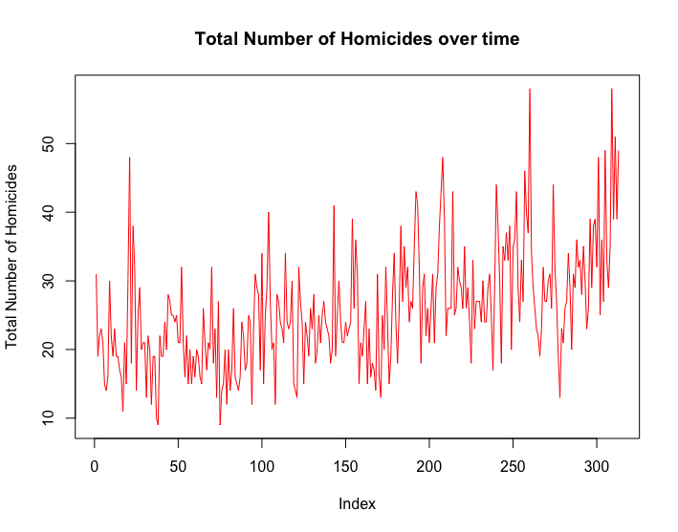
What does the total number of crimes over time look like?
all_homicides <- as.numeric(apply(data[,1:5],1,sum))
plot(all_homicides,type = 'l', ylab = 'Total Number of Homicides', main = 'Total Number of Homicides over time', col = ‘Red’)
Can we observe how the crimes are distributed over time?

Slide 3
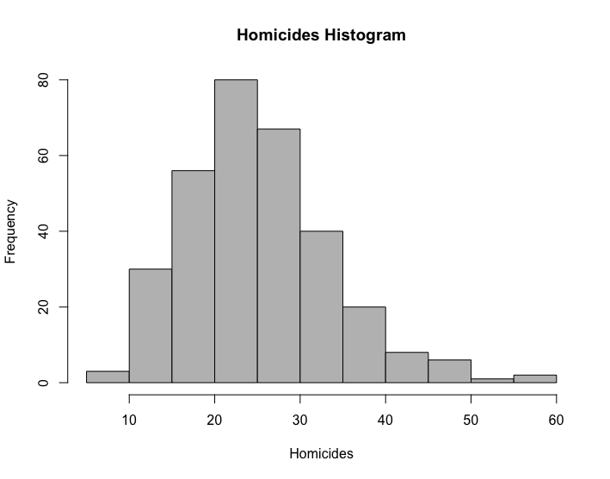
Histogram of the homicides dataset
Even before looking at the histogram, we might already have an idea on what model to use for our mixture, but it might be useful to visualize it before arriving to conclusions.

Slide 4
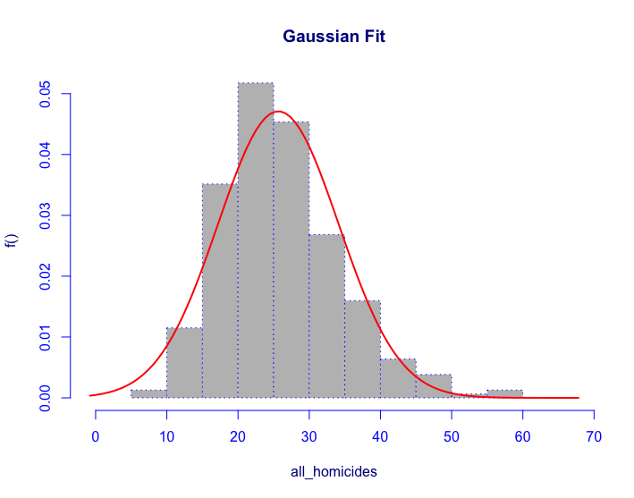
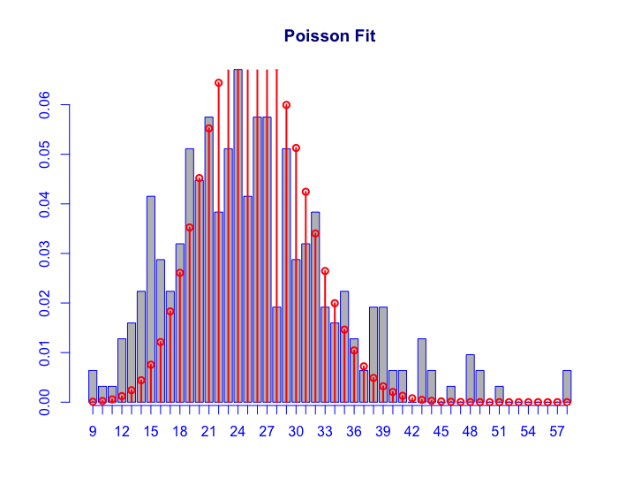
Gaussian vs Poisson
histDist(all_homicides, family = c('NO'), main = 'Gaussian Fit')
histDist(all_homicides, family = c('PO'), main = 'Poisson Fit')

Slide 5
Why Poisson
It makes sense to use Poisson when we have countable number of events occurring in an interval of time.
In this case, we have five different types of homicides over a period of 313 weeks.
We will then proceed by using a multi Poisson distribution for our mixture model and pick the best model according to the BIC

Slide 6
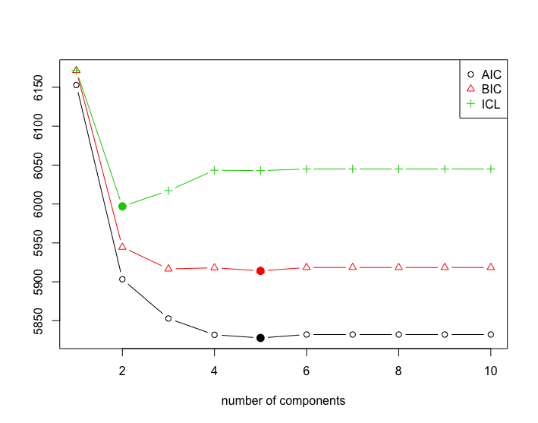
Poisson Mixture
To consider a range of clusters we are going to use stepFlexmix, from the flexmix library.
Where k is the range of values
Nrep is the number of iterations the EM algorithm runs for each k value
The model is the Poisson, FLXMmvpois()
poisson_mix <- stepFlexmix(crime_matrix ~ 1,
k = 1:10, nrep = 5,
model = FLXMCmvpois(),
control = list(tolerance = 1e-15, iter = 1000))

Slide 7
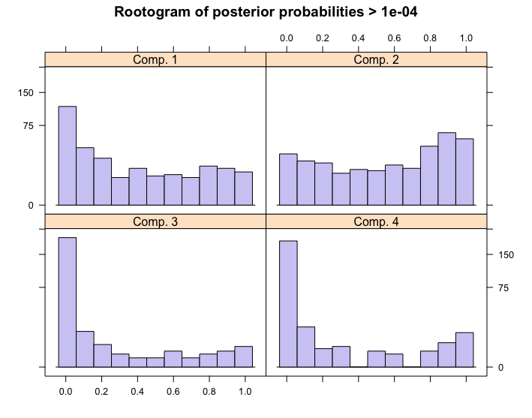
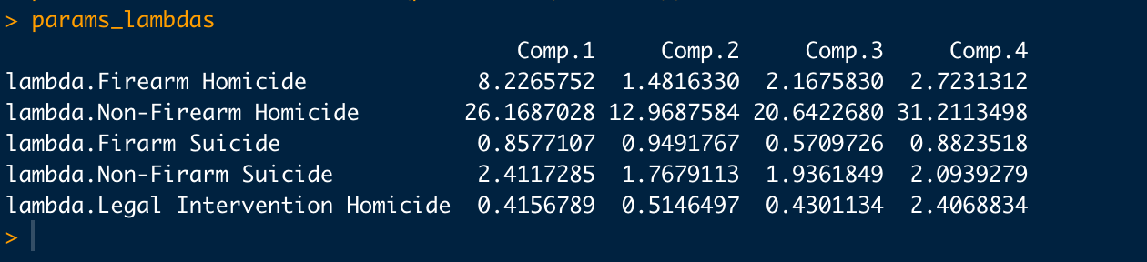
Finding the best model
We can find the best model by using the function getModel.
best_fit <- getModel(poisson_mix, which = ‘BIC’)
This will give us our subpopulation based on the minimization of the BIC, although we can use the same function for the AIC or ICL
In our case, the best fit model has 4 different clusters, we can get the lambda parameters, which can be thought of as the average number of events in an interval of time by using the parameters() function :
params_lambdas <- data.frame(parameters(best_fit))

Slide 8
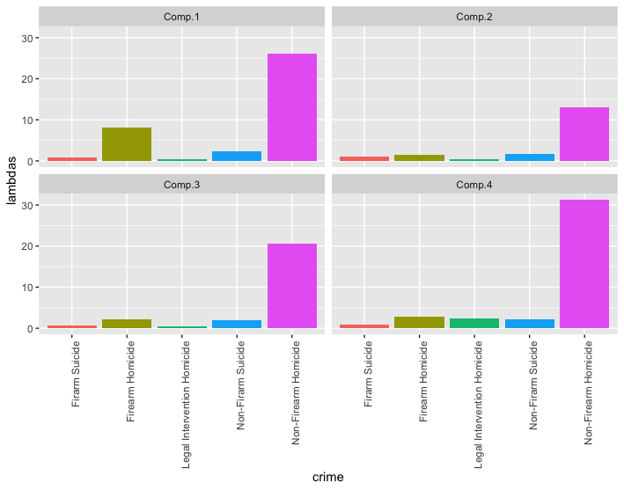
Plotting the clusters
params_lambdas_crime <- params_lambdas %>%
mutate(crime = colnames(crime_matrix))
params_lambdas_crime %>%
gather(cluster, lambdas, -crime) %>%
ggplot(aes(x = crime, y = lambdas, fill = crime)) +
geom_bar(stat = "identity") +
facet_wrap(~ cluster) +
theme(axis.text.x = element_text(angle = 90, hjust = 1), legend.position = "none")
Four meaningful subgroups were found; through the use of clustering with PMM ,we can find the most critical periods of time.

